Slide 1
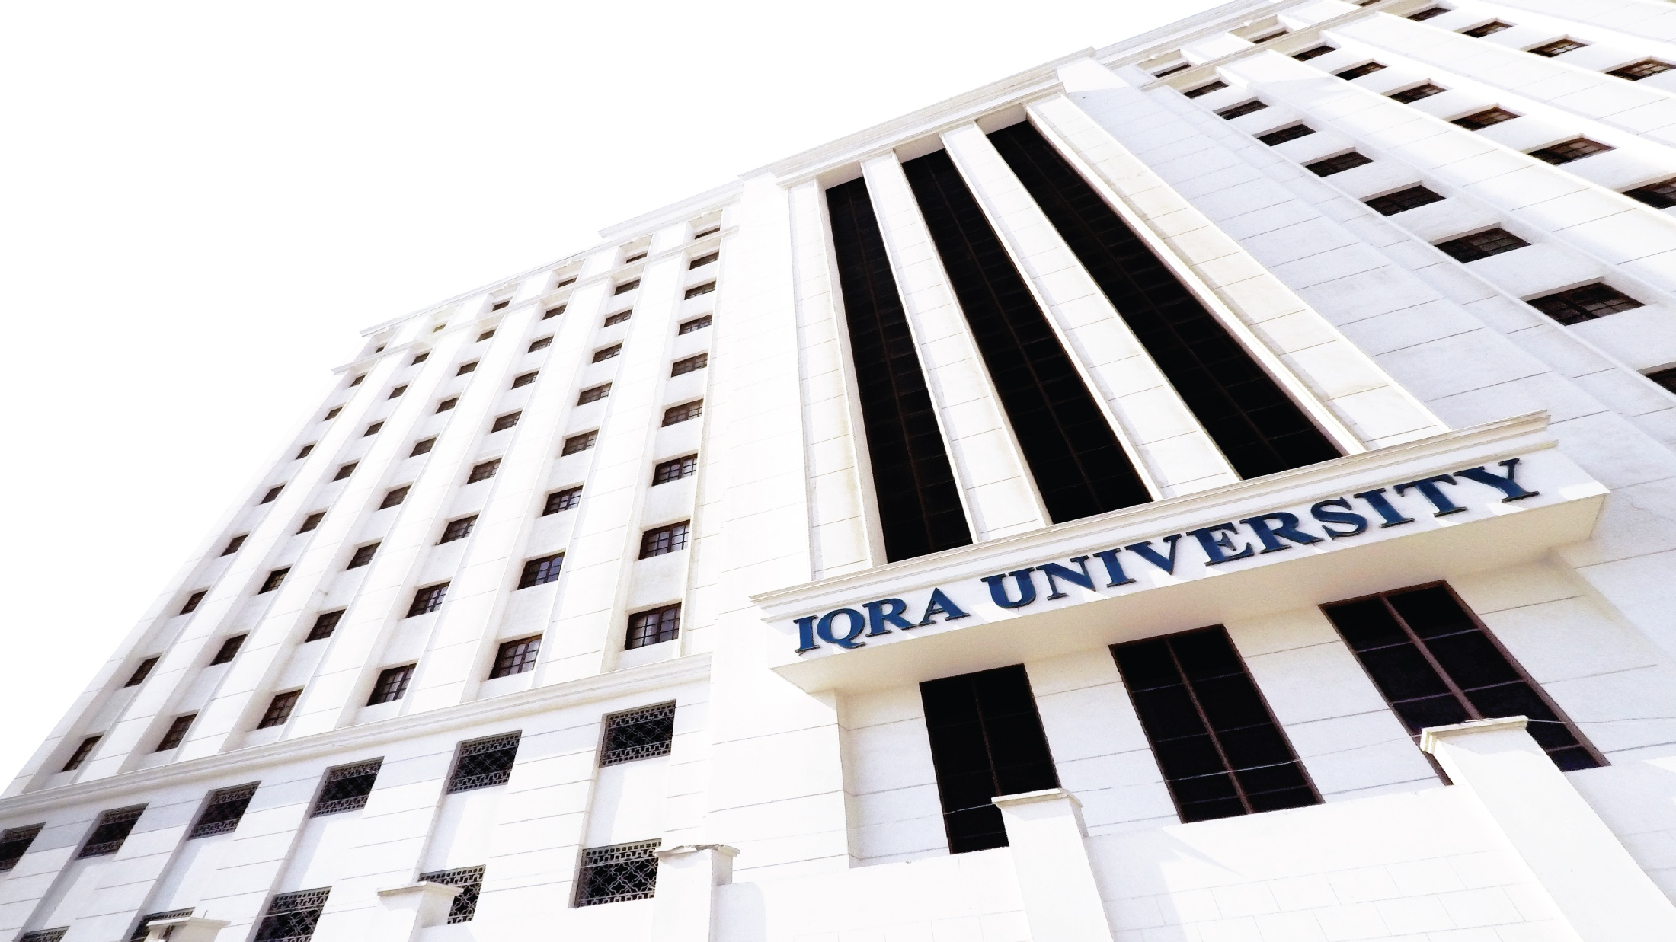

Personal development Plan
Unit 2.2 Forming SMART goals to achieve personal vision
Prepared by the research team

Slide 2
Welcome!!
Unit 1.3 Areas of life for personal development

Slide 3
Learning outcome
Students will be able to prepare smart goals for life from there personal vision statement.
Identify the goal they want to achieve in recent present (Small Goals)

Slide 4
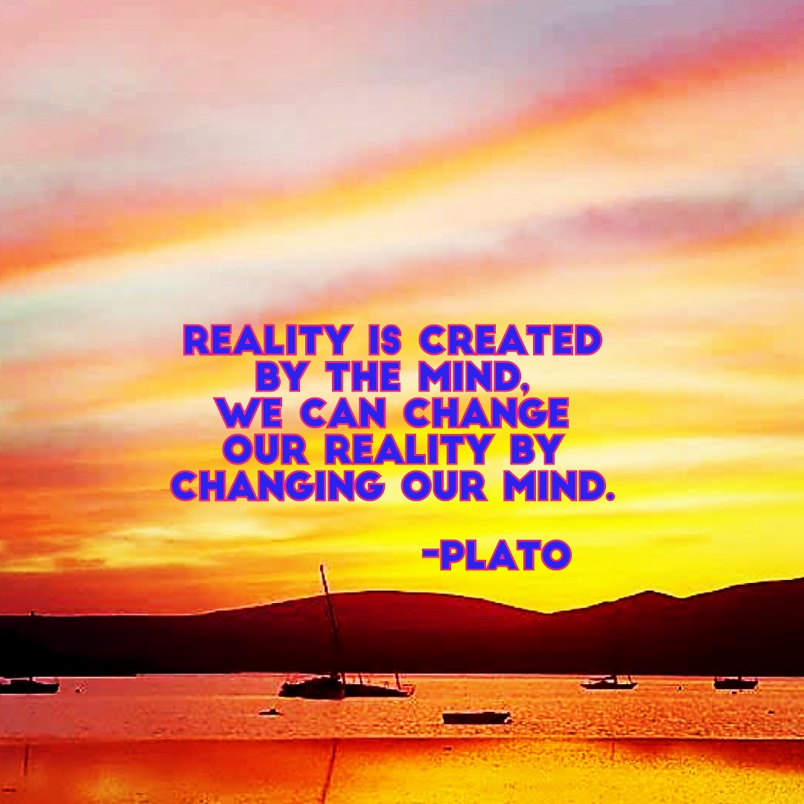

Slide 5
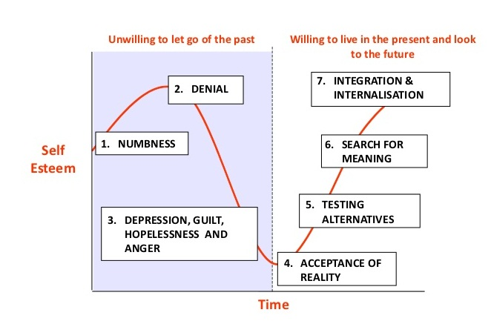
Most of us live in Stage 1,2 or 3 We will try today to reach Stage No.4

Slide 6


Take out your “Personal Development Plan” see template in folder

Slide 7
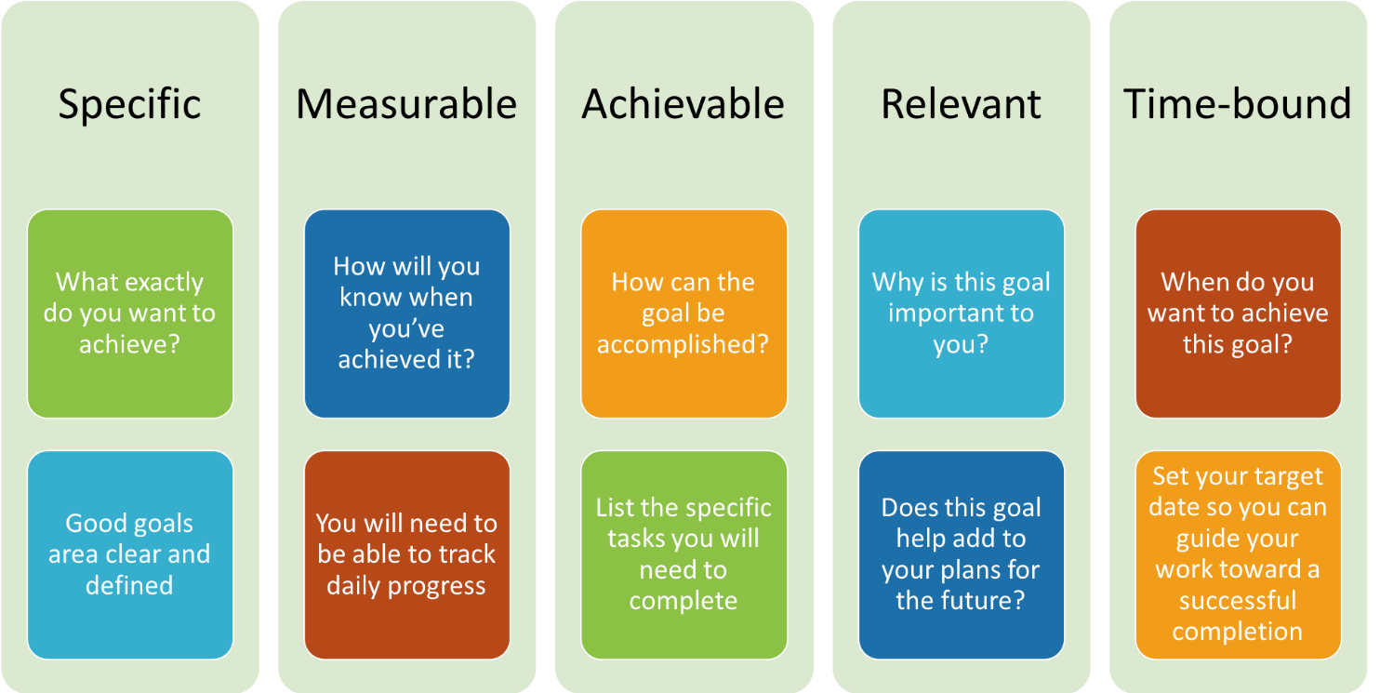
Smart goals

